Slide 1

课时练习
模块七 第三章 第三节

Slide 2
一、翻译下列词组。
1. 切肉 ____________________________________
2. 值得努力 __________________________________
3. 值得做…… ______________________________
4. ……和……（两者）都 ________________________
5. 最后 ________________ / __________________
6. 进展顺利 ____________________________________
cut the meat Festival
be worth the effort
be worth doing …
both … and …
in the end at last
go/work well

Slide 3
二、用括号内所给单词的适当形式填空， 每空不限词数。
1. On the wedding（婚礼） day, we put up some red paper-cuts on the wall to show our best ______ (wish).
2. Attention, please! I have some news about the school field trip________(tell) you.
3. Good habits such as washing hands __________ (regular) are important.
wishes
to tell
regularly

Slide 4
二、用括号内所给单词的适当形式填空， 每空不限词数。
4. To get better grades, Tim listens to the teachers ________________ (careful) than before in class.
5. He wrote his name ________（neat） on the cover of the book.
more carefully
neatly

Slide 5
三、情景交际。
1. 你想知道笔友的近况， 可以在信中这样问：
__________________________________________?
2. 你想知道对方是否经常用筷子吃面条, 可以这样问：
__________________________________________.
How are you these days
Do you often use chopsticks to eat noodles

Slide 6
三、情景交际。
3. 去餐馆吃饭时你想看菜单， 可以这样对服务员说：
_______________________________ , please?
May I have the menu

Slide 7
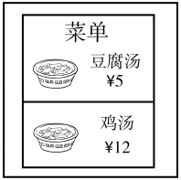
四、看图写话。
1. cheap, than
The tofu soup is (much) cheaper than the chicken soup.

Slide 8
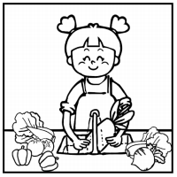
四、看图写话。
2. now
The girl/She is washing vegetables (in the kitchen) now.

Slide 9
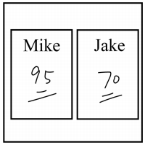
四、看图写话。
3. better, job, in
Mike did a better job than Jake in the exam.

Slide 10
五、熟词生义。
1. bill A. n. 账单 B. n. 钞票 C. n. 议案
_____ (1) Here’s a five dollar bill—please keep the change.
_____ (2) They got the bill through Congress (国会).
_____ (3) She always pays her bills on time.
B
C
A

Slide 11
五、熟词生义。
2. change A. n.& vt. 变化，改变 B. n. 零钱，找头
C. vi.& vt. 换乘，转乘
_____ (1) My dad used to carry a lot of small change in his pocket(口袋).
_____ (2) A change of job would do you the world of good.
_____ (3) I stopped in Moscow only to change planes.
B
A
C

Slide 12
五、熟词生义。
3. course A. n. 课程 B. n. 一道菜 C. n. 进程，过程
_____ (1) She took an online course in art and design.
_____ (2) The main course was beef curry with carrots.
_____ (3) These events changed the course of history.
A
B
C

Slide 13


